Slide 1

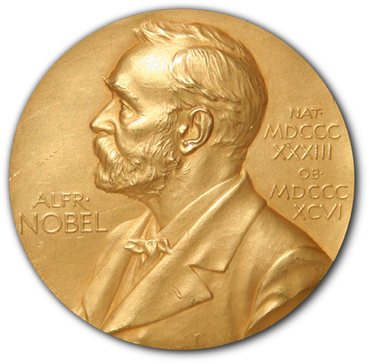
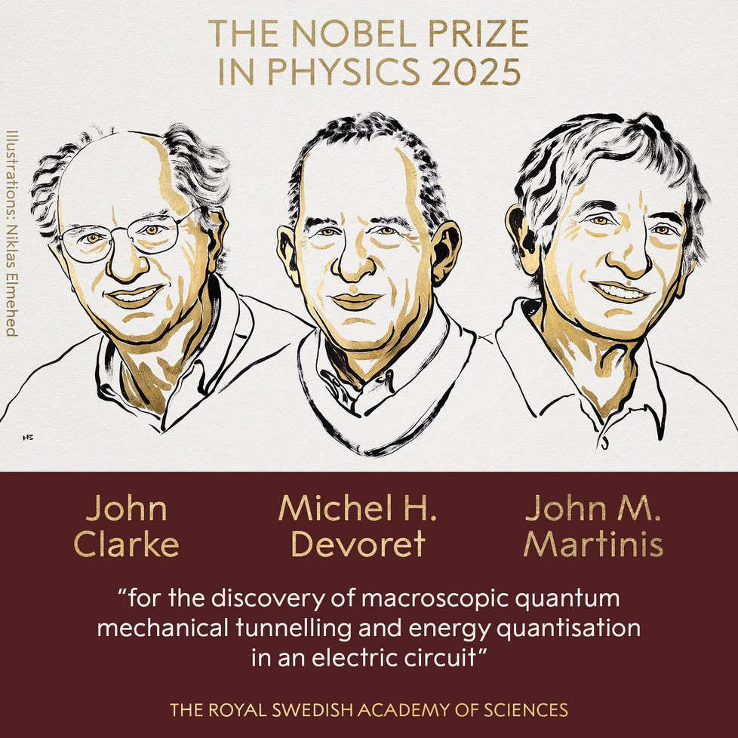

Merry Nobel
Physics

Slide 2
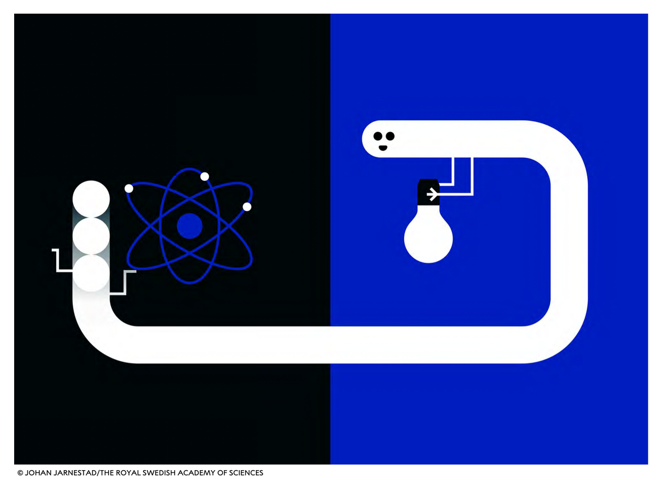
The 2025 physics prize is about quantum
mechanical effects in electrical circuits.

Slide 3
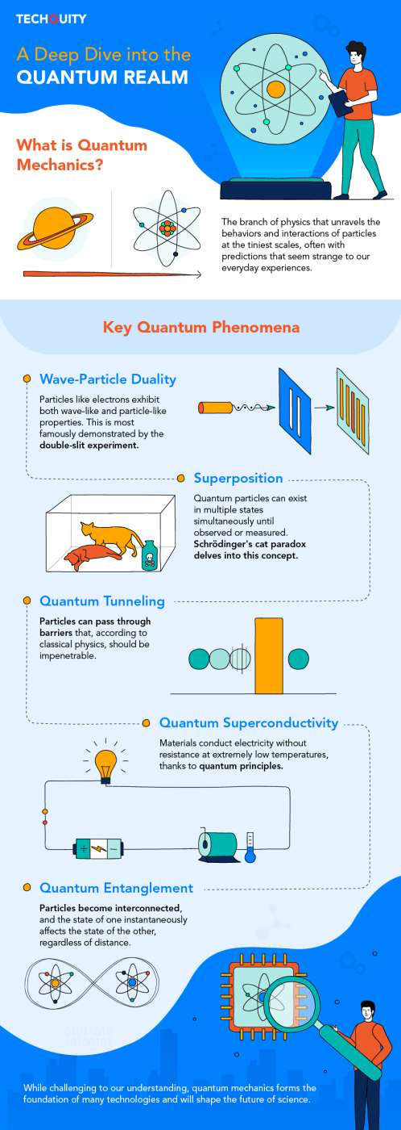
The 2025 physics prize is about quantum
mechanical effects in electrical circuits.

Slide 4
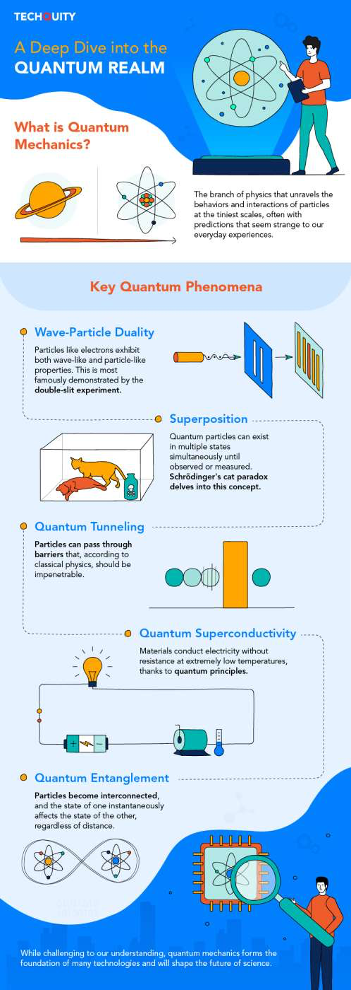
The 2025 physics prize is about quantum
mechanical effects in electrical circuits.

Slide 5
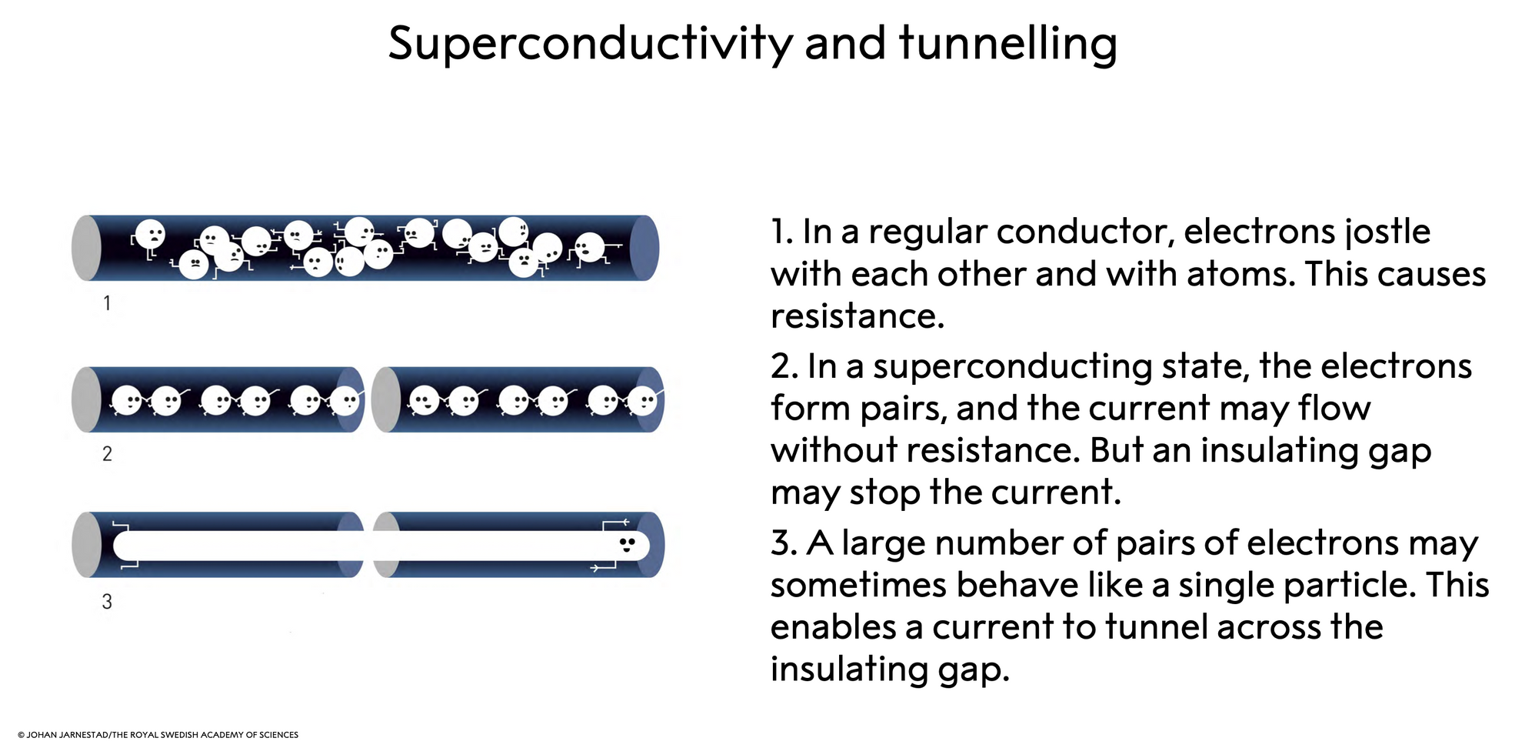
The 2025 physics prize is about quantum
mechanical effects in electrical circuits.

Slide 6
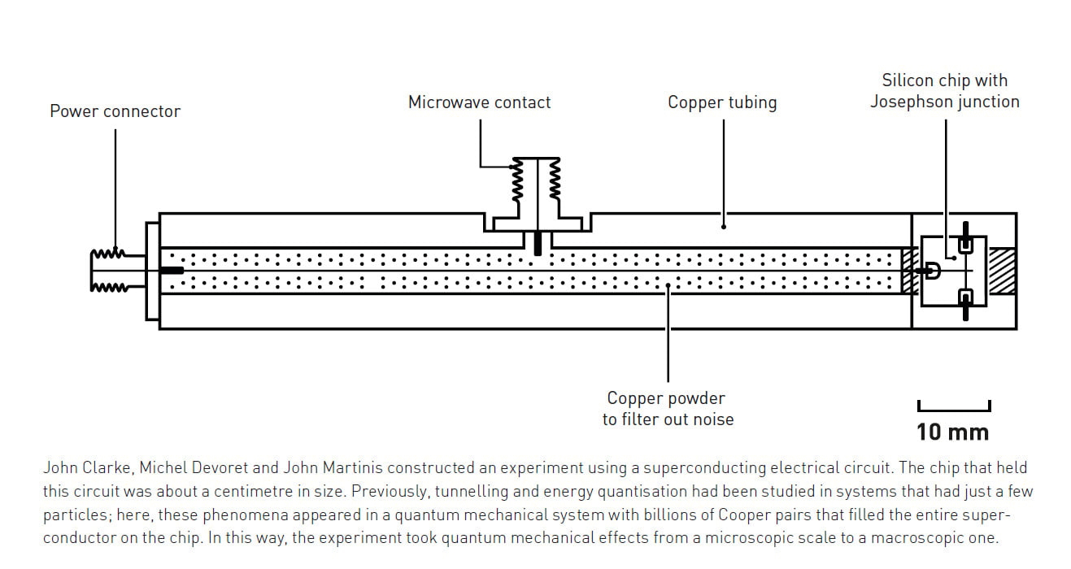
The experiment

Slide 7
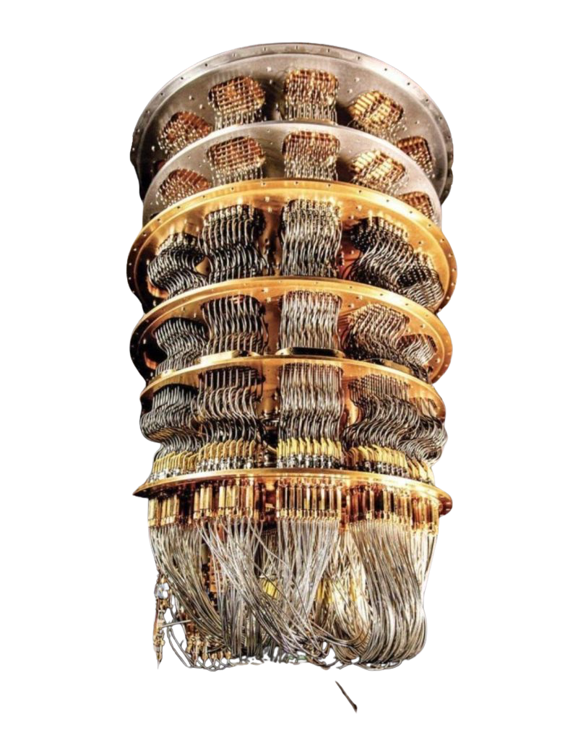
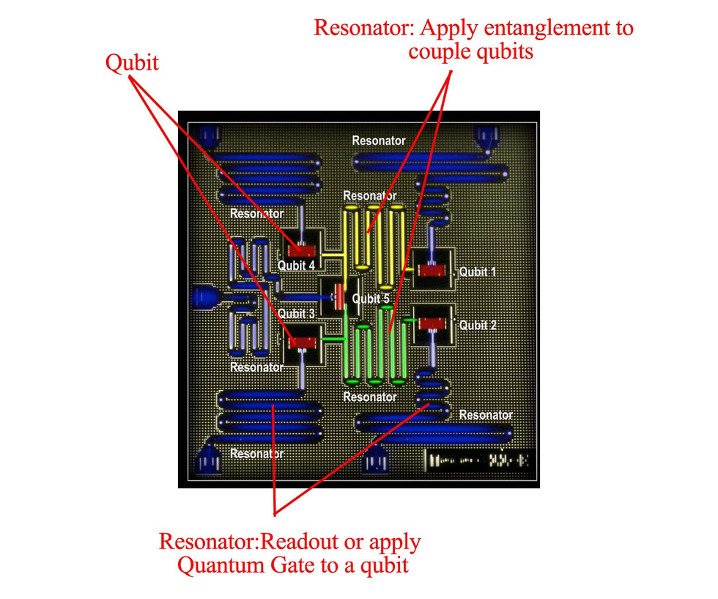
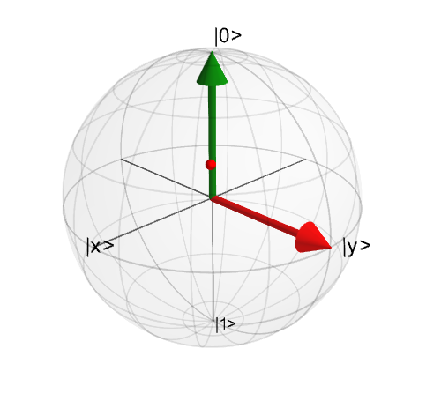
Superconducting quantum compute revolution

Slide 8
Thanks!

